Slide 1
Windows Intro 2
Jordan Lee

Slide 2
What we’ll cover
How to set up VMs and what is the necessary software?
What is auditing in Windows and how do we audit to maximize your gain of points?
What is Run and why is it useful?
What are Windows services and what configurations are most optimal for competitions?
What is Windows secpol and what is the most optimal configuration for competitions?

Slide 3
VMware setup
Download VMware Workstation player (latest version should work fine)
https://www.vmware.com/products/workstation-player/workstation-player-evaluation.html
Two types of operating systems
Windows 10
100 points
Everyday use
Windows Server 2019
100 points
Manages many computers, files, and services

Slide 4
Auditing
Diagnoses performance problems and security risks in the operating system
Tracks important events that take place
start/run/control panel
Administrative tools → Local security policy → Audit policy
Option
Success/Failure
Success
Failure

Slide 5
Run
A shortcut access program that runs different programs and opens different settings
To access
Windows key + r
Full list of commands
https://ss64.com/nt/run.html
May be useful to some people

Slide 6
Windows services
Windows services manages different applications running in the background of the operating system
Most start when the computer is booted and run until it is shut down
How to access
Run
Services.msc
start/control panel
Administrative tools → services

Slide 7
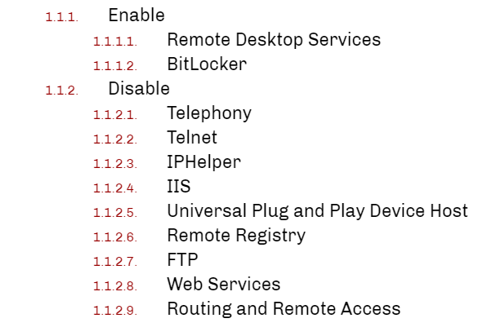
Windows services pt.2
Configurations depend on the contest scenario
https://www.cisecurity.org/benchmark/microsoft_windows_desktop/
Stop malicious and unnecessary programs

Slide 8
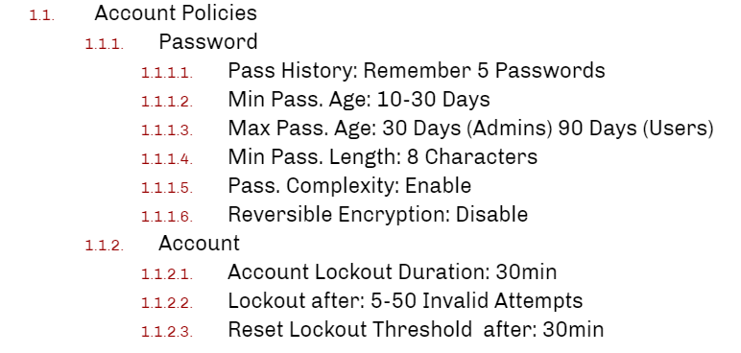
Local security policy
A set of information about the security of a local computer operates
Encompasses a lot of different settings and configurations often give easy points in competition
How to access
Run/start
Secpol.msc
Security settings
Account policies
Local policies
Also may depend on contest scenario

